Slide 1
POS solutions
Jae Whan Woo
Josh Standiford
Scott Thompson
Brandon Tesar
Ian Maliszewskyj

Slide 2
Purpose
This web app intends to be a software solution to an inefficient purchasing system at ADG Creative. The current purchasing system is an “honor” system and is paper based. The company has a cafe that offer various items to employees. There is a stack of papers with tables on them. An employee who wants to purchase something will take a sheet of paper from the stack, check off what items they want, sign and date the sheet and pile it on another stack of signed sheets. Accountants will then take the stack of signed sheets and deduct from appropriate pay rolls.

Slide 3
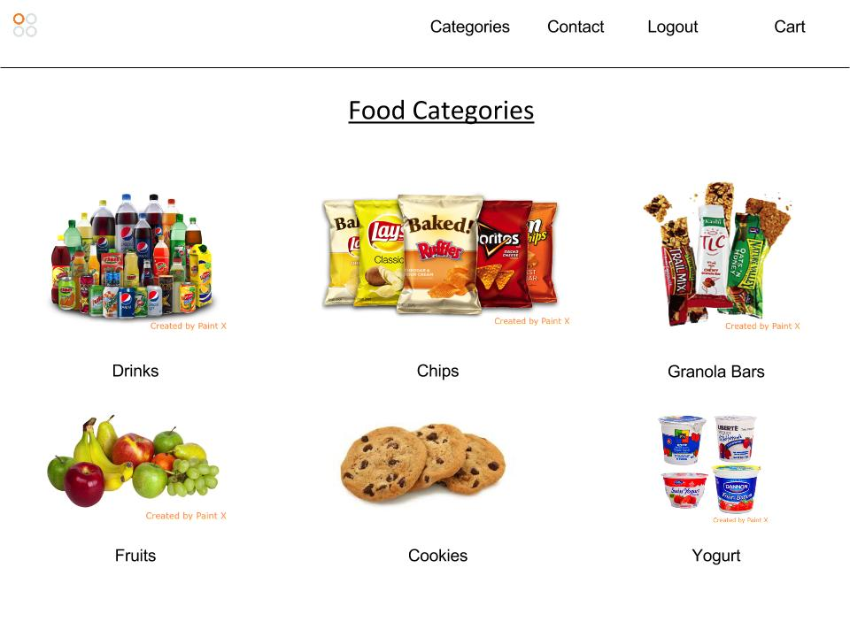
Usecase 1

Slide 4
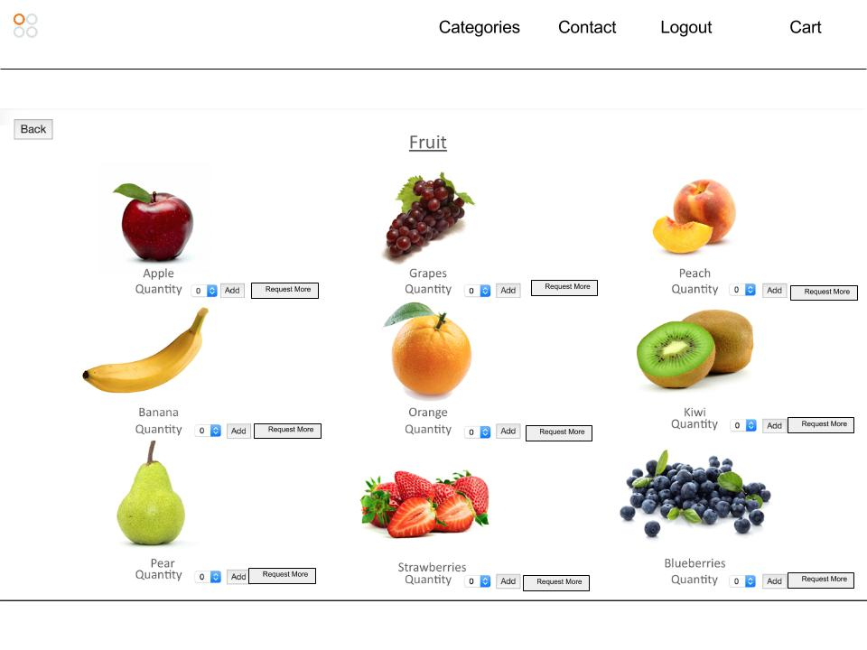
Usecase 2(a)

Slide 5
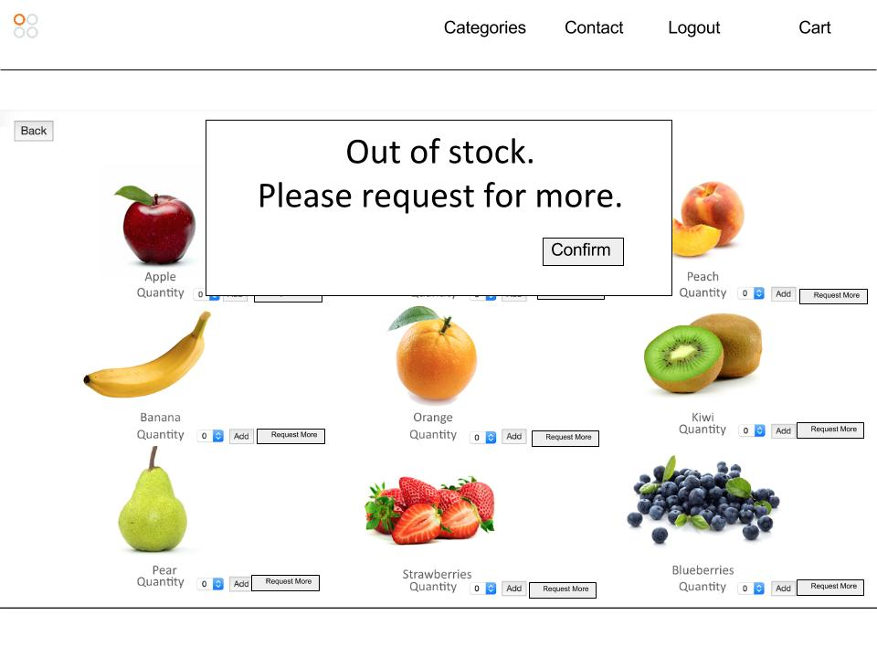
Usecase 2(b)

Slide 6
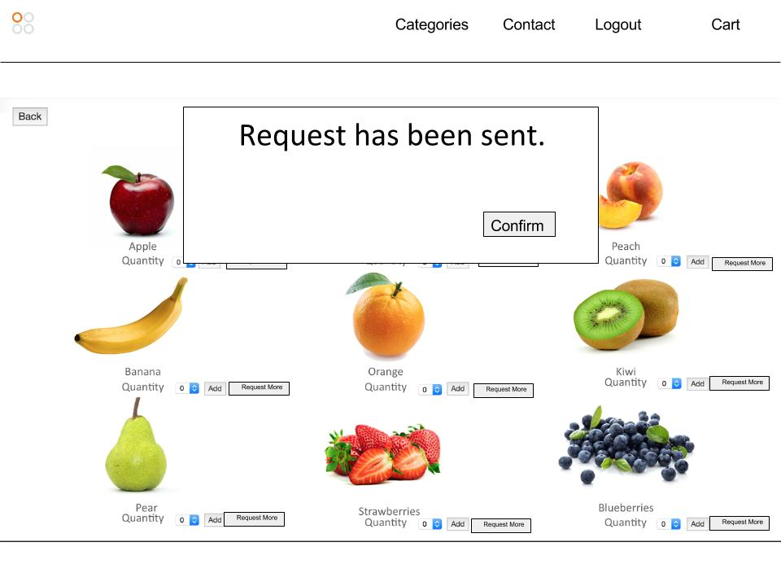
Usecase 4

Slide 7
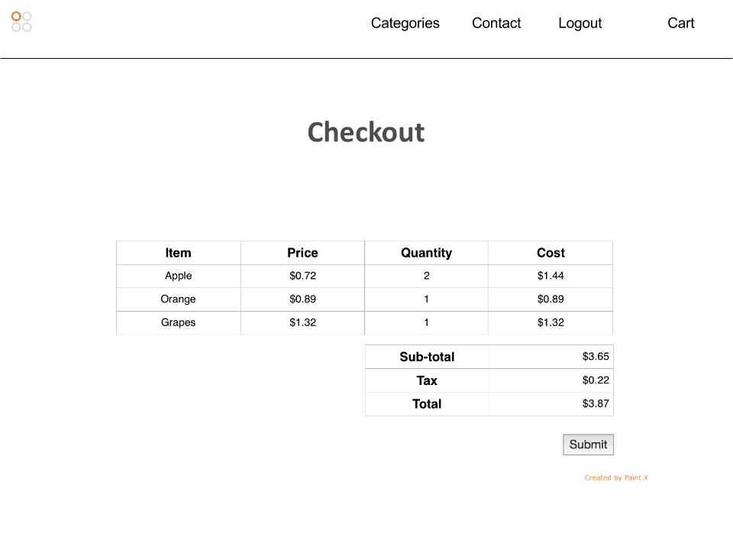
Usecase 2(c)

Slide 8
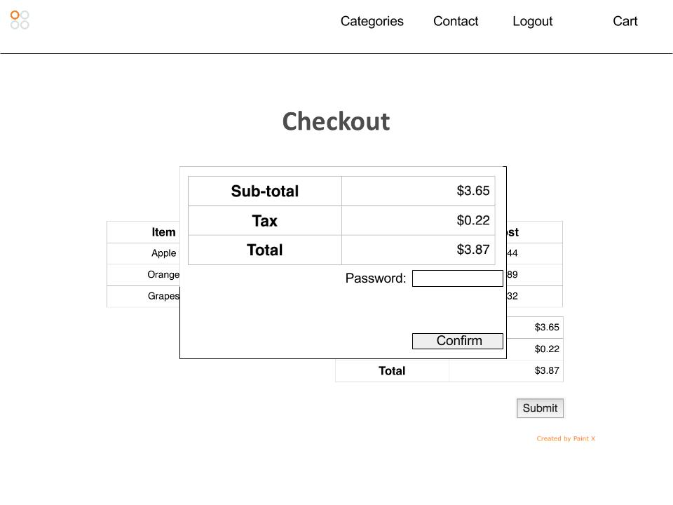
Usecase 2(d)

Slide 9
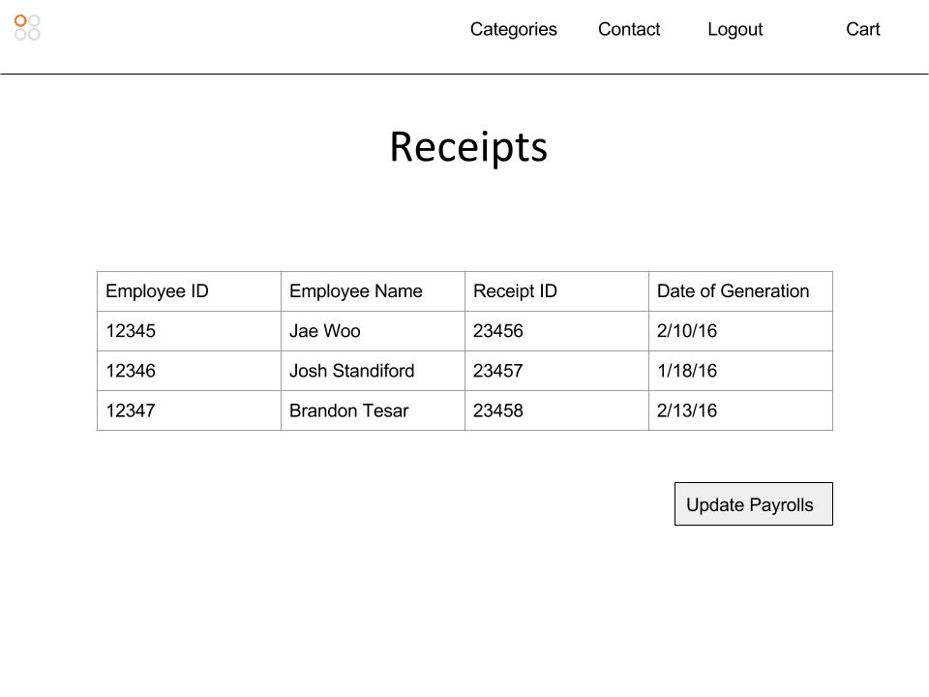
Usecase 3

Slide 10
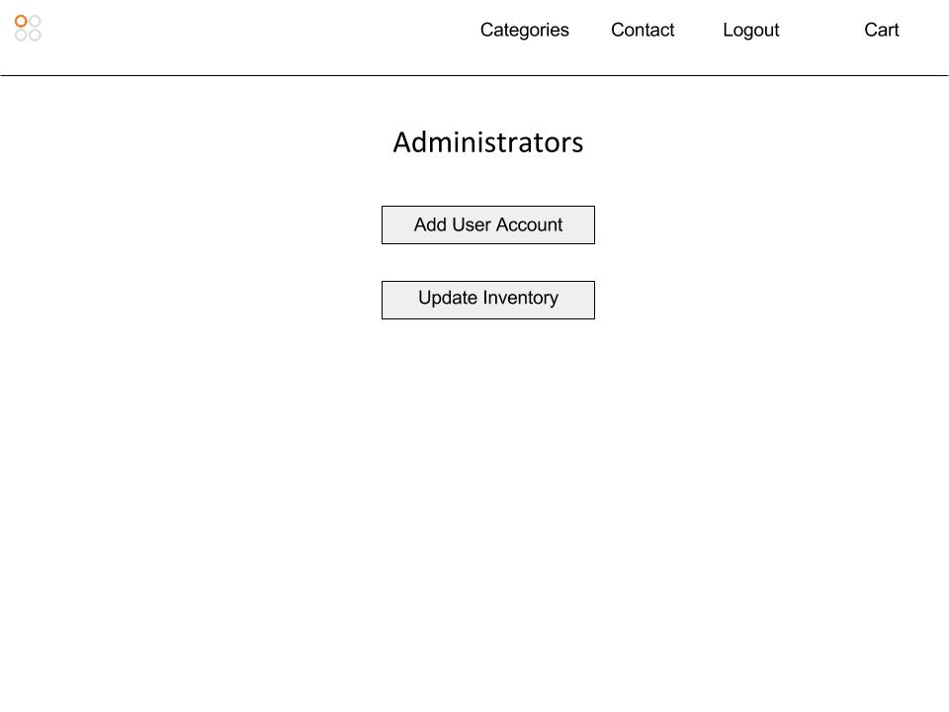
Usecase 5(a)

Slide 11
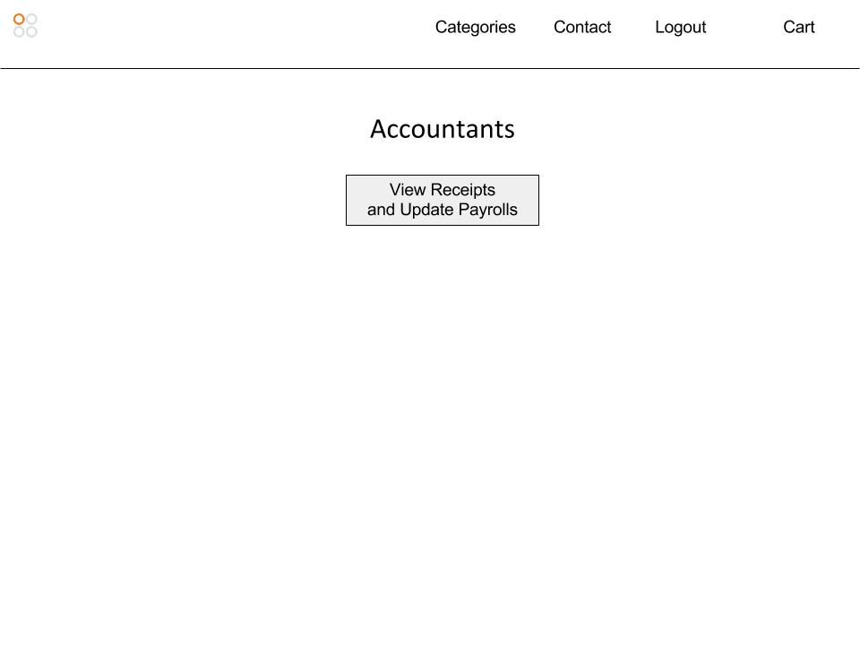
Usecase 5(b)

Slide 12
Databases
The webpage will use 2 tables.
The User_info table will store user (employee) names, their pins, and the debt accrued from purchases.
The Inventory table will store quantity information for any given item.

